Slide 1
UNIX C++ Programming Review
School of Information and Communication Technology,
Hanoi University of Science and Technology

Slide 2
References
[1] W.Richard Stevens, Unix Network Programming Vol.1, 3rd Ed., Prentice Hall.
[2] Keir Davis, John W. Turner, and Nathan Yocom, The Definitive Guide to Linux Network Programming, Apress.
[3] Michael Donahoo, Kenneth Calvert, TCP/IP Sockets in C: Practical Guide for Programmers, Elsevier.

Slide 3
Content
Creating, Compiling and Running Your Program
C/C++ Basics
C/C++ Advances
Input and Output
String Handling
File Access and Directory System Calls
Process Control

Slide 4
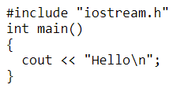
Creating, Compiling and Running
There are a number of compilers
cc (Sun Solaris)
bcc (Borland)
gcc
Simple compilation command
g++ hello.C -o hello
Compile with debug (gdb) option
g++ -g myprog.C -o myprog

Slide 5
Creating, Compiling and Running
Compiling multiple source files
g++ file1.C file2.C -o myprog
g++ -c file1.C
g++ -c file2.C
g++ file1.o file2.o -o myprog

Slide 6
Creating, Compiling and Running
Useful options
-c: suppress linking, produce object files only
-l<lib>: link with library
cc calc.c -o calc –lm
-L<dir>: add directory to the library searching path
cc prog.c -L/home/myname/mylibs mylib.a
-I<dir>: add directory to the header searching path
-g: enable debugging with gdb

Slide 7
C/C++ Basics
Data types
char, short, int, long
float, double
array
string
Conditions
if-else
switch-case
Looping and Iteration
for
while
do-while

Slide 8
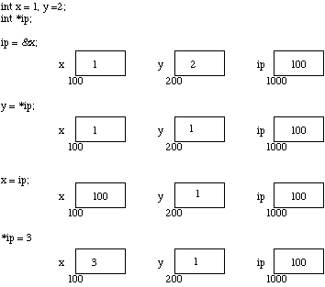
C/C++ Advances
Pointer
A variable which contains the address in memory of another variable

Slide 9

C/C++ Advances
We can do integer arithmetic on a pointer

Slide 10
Excercise
Input a float number
Using pointer to access its memory and
Print 4 bytes representing the float number
Using a simple value (Ex: 1.5) to validate the IEEE 754 representation MANUALLY

Slide 11

C/C++ Advances
Pointers and arrays are very closely linked in C
int a[10], x;
int *pa;
pa = &a[0]; /* pa pointer to address of a[0] */
x = *pa;
/* x = contents of pa (a[0] in this case) */

Slide 12
C/C++ Advances
Dynamic Memory Allocation
memset(pointer, value, bytecount)
memcpy(dest_pointer, src_pointer, bytecount);
void *malloc(size_t number_of_bytes)
int *ip;
ip = (int *) malloc(100*sizeof(int));
void *calloc(size_t num_elements, size_t element_size}
ip = (int *) calloc(100, sizeof(int));
void *realloc( void *ptr, size_t new_size);
ip = (int*) realloc(101, sizeof(int));

Slide 13
Excercise
Input a float from the stdin until a ZERO is entered
Store all the float values into a dynamically-allocated array (use malloc, alloc, realloc)
Print out the sum of those floats

Slide 14

C/C++ Advances
Pointers to pointers
char ch; /* a character */
char *pch; /* a pointer to a character */
char **ppch; /* a pointer to a pointer to a character */
An example of pointers to pointers is in the main()
int main (int argc, char **argv)

Slide 15
C/C++ Advances
Pointer to functions
Store the address of a function in a pointer
Passing and calling function using variables
Very useful to provide call-back mechanism in many application
typedef void (*printer_t)(int);
void print_to_n(int n)
{
for (int i = 1; i <= n; ++i) printf("%d\n", i);
}
printer_t p = &print_to_n;
p(5); // Prints 1 2 3 4 5 on separate lines

Slide 16
Input and Output
#include <stdio.h>
Reporting Errors
perror()
errno
exit()
Streams
stdin
stdout
stderr

Slide 17
Input and Output
stdin and stdout can be used with files, programs, I/O devices such as keyboard, console, etc.
stderr always goes to the console or screen
The console is the default for stdout and stder
The keyboard is the default for stdin
Predefined stream are automatically open
Stream redirection (OS command line)
prog1 > file1: send output to a file
prog2 < file2: input from a file
prog1 | prog2: pipe stdout of prog1 to stdin of prog2

Slide 18
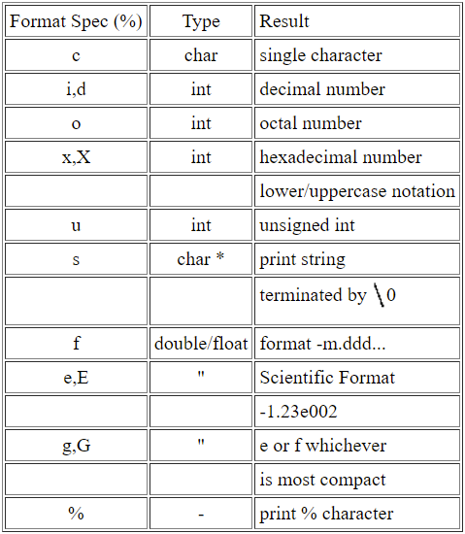
Input and Output
int getchar(void)
int putchar(char ch)
int printf(char *format, arg list ...)
int scanf(char *format, args....)
int sprintf(char *string, char *format, args..)
int sscanf(char *string, char *format, args..)

Slide 19
Input and Output
Files
FILE *fopen(char *name, char *mode)
Reading: mode = “rt”, “rb”
Writing: mode = “wt”, “wb”
Appending: mode = “at”, “ab”
int fprintf(FILE *stream, char *format, args..)
int fscanf(FILE *stream, char *format, args..)
int getc(FILE *stream)
int fgetc(FILE *stream)
int putc(char ch, FILE *s)
int fputc(char ch, FILE *s)
fflush(FILE *stream)
fclose(FILE *stream)

Slide 20
Input and Output
Stream Status Enquiries
int feof(FILE *stream);
int ferror(FILE *stream);
void clearerr(FILE *stream);
int fileno(FILE *stream);

Slide 21
Input and Output
Low Level I/O
This form of I/O is UNBUFFERED
There are no formatting facilities
This means we are now using binary (and not text) files
int open(char *filename, int flag, int perms)
flag = O_APPEND, O_CREAT, O_RDWR...
Perms = 0 for most applications
Return a file descriptor or -1 (failed)
int close(int handle) -- close a file
int read(int handle, char *buffer, unsigned length)
int write(int handle, char *buffer, unsigned length)

Slide 22
String Handling
#include <string.h>
char *stpcpy (char *dest,const char *src) -- Copy one string into another.
int strcmp(char *string1,const char *string2) - Compare string1 and string2 to determine alphabetic order.
char *strcpy(char *string1,const char *string2) -- Copy string2 to stringl.
char *strerror(int errnum) -- Get error message corresponding to specified error number.
size_t strlen(const char *string) -- Determine the length of a string.
char *strncat(char *string1, char *string2, size_t n) -- Append n characters from string2 to stringl.
int strncmp(char *string1, char *string2, size_t n) -- Compare first n characters of two strings.
char *strncpy(char *string1,const char *string2, size_t n) -- Copy first n characters of string2 to stringl .
int strcasecmp(const char *s1, const char *s2) -- case insensitive version of strcmp().
int strncasecmp(const char *s1, const char *s2, int n) -- case insensitive version of strncmp().

Slide 23
String Handling
Searching
char *strchr(const char *string, int c) -- Find first occurrence of character c in string.
char *strrchr(const char *string, int c) -- Find last occurrence of character c in string.
char *strstr(const char *s1, const char *s2) -- locates the first occurrence of the string s2 in string s1.
char *strpbrk(const char *s1, const char *s2) -- returns a pointer to the first occurrence in string s1 of any character from string s2, or a null pointer if no character from s2 exists in s1
size_t strspn(const char *s1, const char *s2) -- returns the number of characters at the begining of s1 that match s2.
size_t strcspn(const char *s1, const char *s2) -- returns the number of characters at the begining of s1 that do not match s2.
char *strtok(char *s1, const char *s2) -- break the string pointed to by s1 into a sequence of tokens, each of which is delimited by one or more characters from the string pointed to by s2.
char *strtok_r(char *s1, const char *s2, char **lasts) -- has the same functionality as strtok() except that a pointer to a string placeholder lasts must be supplied by the caller.

Slide 24
Memory Operations
void *memchr (void *s, int c, size_t n) -- Search for a character in a buffer .
int memcmp (void *s1, void *s2, size_t n) -- Compare two buffers.
void *memcpy (void *dest, void *src, size_t n) -- Copy one buffer into another .
void *memmove (void *dest, void *src, size_t n) -- Move a number of bytes from one buffer lo another.
void *memset (void *s, int c, size_t n) -- Set all bytes of a buffer to a given character.

Slide 25
File Access & Directory System Calls
int chdir(char *path) -- changes directory to specified path string
char *getwd(char *path) -- get the full pathname of the current working directory
scandir(char *dirname, struct dirent **namelist, NULL, NULL)
int access(char *path, int mode) -- determine accessibility of file, return 0 for success or -1 for failure. mode = R_OK, W_OK, X_OK, F_OK
int stat(char *path, struct stat *buf)
int fstat(int fd, struct stat *buf)

Slide 26
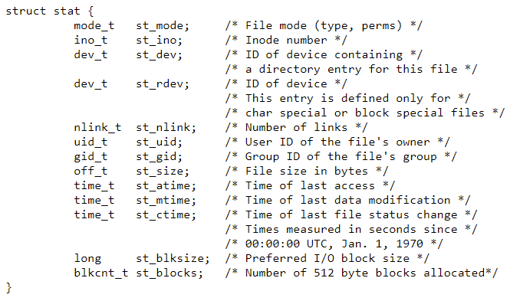
File Access & Directory System Calls

Slide 27
File Access & Directory System Calls
int remove(const char *path);
int rename(const char *old, const char *new);
FILE *tmpfile(void) creates a temporary file and opens a corresponding stream. The file will automatically be deleted when all references to the file are closed.

Slide 28
Process Control
A process is basically a single running program
Running UNIX Commands from C/C++
int system(char *string)
main()
{
printf("Files in Directory are:\n");
system("ls -l");
}
system is a call that is made up of 3 other system calls: execl(), wait() and fork()

Slide 29
Exercise 1
Using system to excute “ifconfig” and display all the IPs of the linux machine
Using system to excure “ls –a –l” and display a list of file including names and sizes
Using scandir to build a list of sub folders and files. Display the result in html format like below:
<a href = “FolderA”><b>FolderA</b></a>
<a href = “FolderB”><b>FolderB</b></a>
<a href = “FileName1><i>FileName1</i></a>
<a href = “FileName2><i>FileName2</i><a/></html>
Wait for a text input, check if
It is a folder in the current path: go into the folder and list again
It is “..” go up (if the current folder is not the root) and list again

Slide 30
Process Control
execl(): execute and leave
execl(char *path, char *arg0,...,char *argn, 0)
main()
{
printf("Files in Directory are:\n");
execl("/bin/ls","ls", "-l",0);
}

Slide 31
Process Control
int fork() turns a single process into 2 identical processes, known as the parent and the child
The child process will have its own unique PID
main()
{
int return_value;
printf("Forking process\n");
fork();
printf(“ The process id is %d
and return value is %d\n",
getpid(), return_value);
execl("/bin/ls/","ls","-l",0);
printf("This line is not printed\n");
}

Slide 32
Process Control
int wait (int *status_location) -- will force a parent process to wait for a child process to stop or terminate
wait() return the pid of the child or -1 for an error
void exit(int status) -- terminates the process which calls this function and returns the exit status value

Slide 33
Q&A

Slide 34
Project 1 (Max 10)
POP3 eMail client
Connect to a POP3 mail server (local or global)
Login
Get email list and status
Get email’s content (include attachment)
Send email to a user with attachment

Slide 35
Project 2 (Max 10)
SMTP eMail client
Connect to a SMTP mail server (local or global)
Login
Get email list and status
Get email’s content (include attachment)
Send email to a user with attachment

Slide 36
Project 3 (Max 9)
FTP Client (Standard Protocol)
Connect to a FTP Server
Login
Get file list
Change directory
Download and upload files

Slide 37
Project 4 (Max 8.5)
Chat room server
Server
Maintains a list of client accounts
Maintains a list of rooms
Forward messages from a client to others in the same room
Client
Login to the server
Get the list of rooms and join one room
Send message to chat with others in the same room
Leave the room
Define your own protocol

Slide 38
Project 5 (Max 10)
P2P File Share
Define your own P2P file sharing protocol
A tracking server to maintain information about files to be shared and locations of those files
Tracking server return the file’s information to a client
Clients work together to get the requested file

Slide 39
Project 6 – IRC Chat Client (Max 8.5)
Connect to a local IRC chat server
Send joining request
Send and receive messages from a channels

Slide 40
Project 7a (Text-Based) (Max 8.5)
Caro chess server
Maintain a list of player accounts
Maintain a list of playing boards
Update a board when receiving input from a player
Check if a game is finished and send winning announcement to the players and finish the game
Caro chess client
Login to the server
Match with a free player (who is not playing any game)
Start the game until it is finished by the server or the player can quit the game
Define your own protocol

Slide 41
Project 7b (Binary-Based) (Max 8.5)
Caro chess server
Maintain a list of player accounts
Maintain a list of playing boards
Update a board when receiving input from a player
Check if a game is finished and send winning announcement to the players and finish the game
Caro chess client
Login to the server
Match with a free player (who is not playing any game)
Start the game until it is finished by the server or the player can quit the game
Define your own protocol

Slide 42
Project 8a (Text-Based) (Max 8.5)
Chess server
Maintain a list of player accounts
Maintain a list of playing boards
Update a board when receiving input from a player
Check if a game is finished and send winning announcement to the players and finish the game
Chess client
Login to the server
Match with a free player (who is not playing any game)
Start the game until it is finished by the server or the player can quit the game
Define your own protocol

Slide 43
Project 8b (Binary-Based) (Max 8.5)
Chess server
Maintain a list of player accounts
Maintain a list of playing boards
Update a board when receiving input from a player
Check if a game is finished and send winning announcement to the players and finish the game
Chess client
Login to the server
Match with a free player (who is not playing any game)
Start the game until it is finished by the server or the player can quit the game
Define your own protocol

Slide 44
Project 9a (Max 8.5)
Define your own text-based FTP protocol and implement
FTP client
FTP server
Your FTP client and server should be able to
Handle user account and home folder
Handle user login
Handle multiple clients
Handle file downloading and uploading like the well-known FTP protocol
Your protocol can be simpler than the well-known FTP protocol

Slide 45
Project 9b (Max 8.5)
Same as 9a but the protocol is binary-based

